Slide 1
Adding protein-ligand interaction descriptors
Team 3A
July 13, 2020
Team Lead: Ravi Abrol
Email: abrol@csun.edu

Slide 2
Team 3A
Sreeranjini Babu
Sridhar Malkaram
Aaron Ayllon-Benitez
Rachita K Kumar
Sangram Keshari Sahu
Ravi Abrol

Slide 3
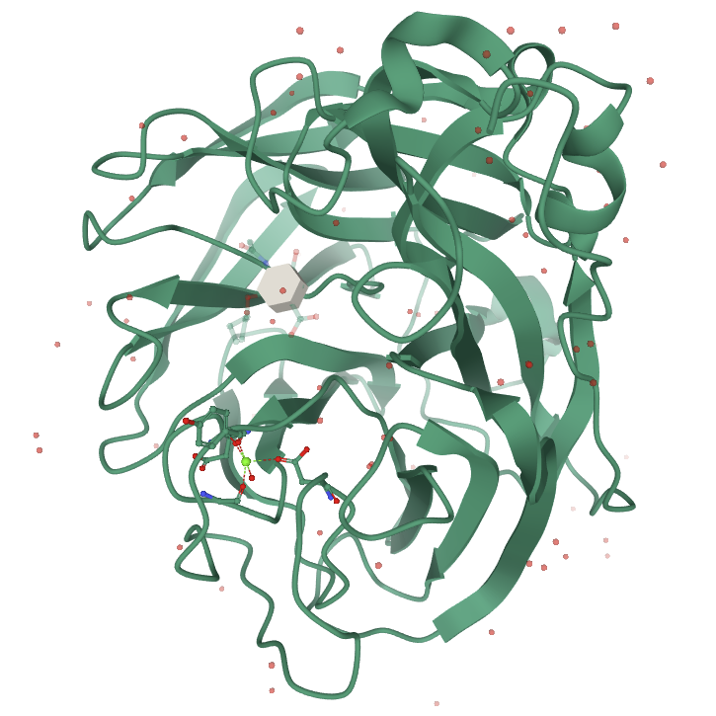
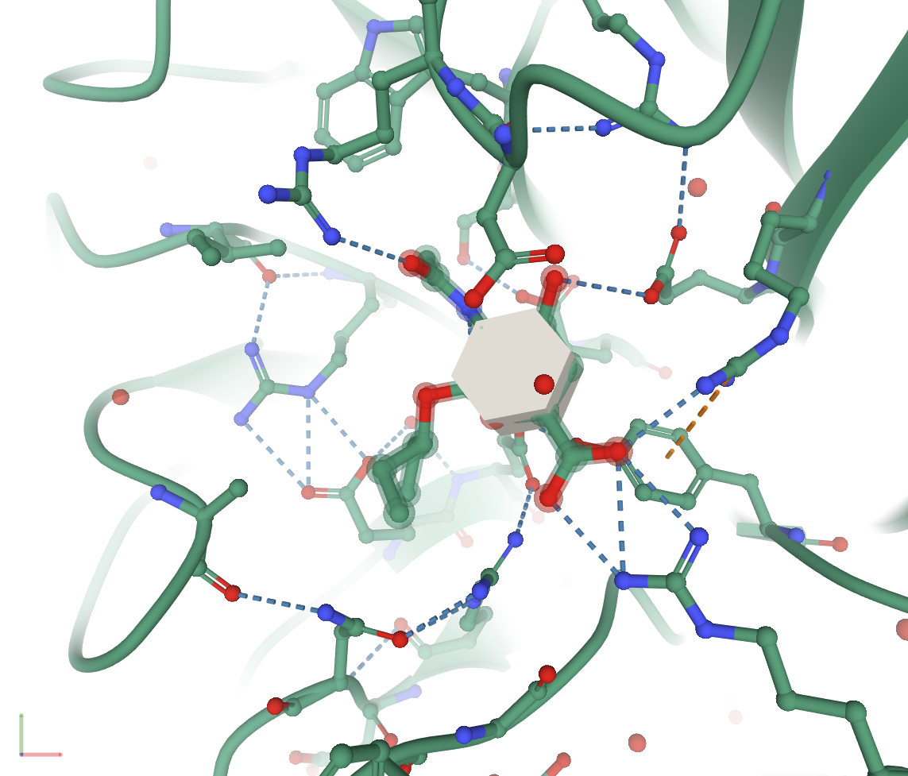
Structure of an anti-viral compound bound to influenza virus protein

Slide 4
Protein-Ligand Interactions
Overall GOAL:
Analyze PDB structures of ligands bound to proteins using PLIP server in terms of:
hydrogen bonds
water bridges
salt bridges
halogen bonds
hydrophobic interactions
π-stacking
π-cation interactions
metal complexes

Slide 5
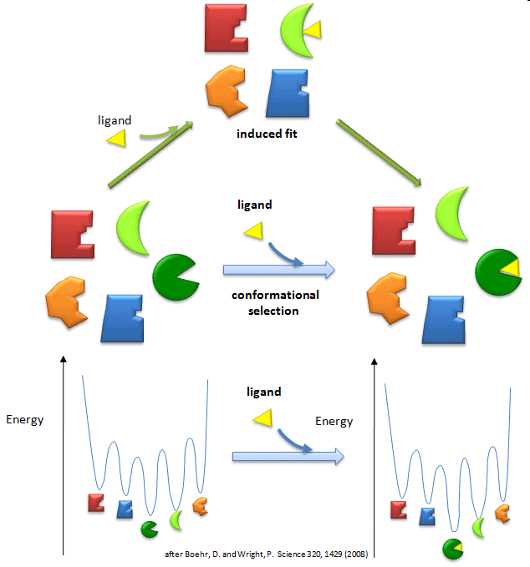
Protein-Ligand Interactions
Multiple Lock – Multiple Key Model
(Conformational Selection)
Protein conformations
Ligand conformations
Conformational selection
leads to binding
AND / OR
Induced Fit Model
Flexible protein
Flexible ligand
Loose fit induces mutual
conformational change for
strong binding

Slide 6
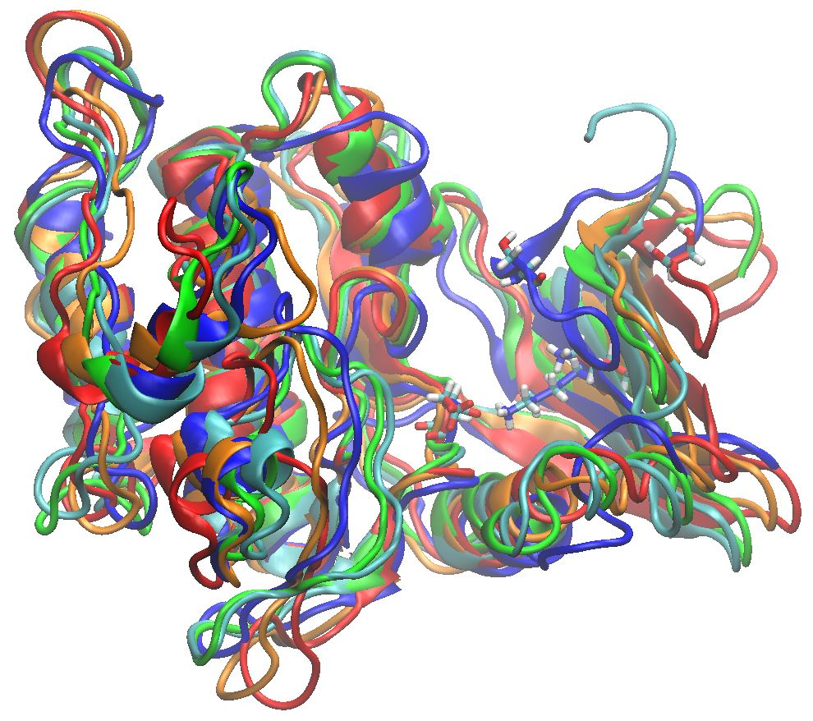
Protein Backbone Flexibility
A Protein Kinase in Multiple Conformations
Ser591
Lys612
Asp727
Glycine-rich Loop

Slide 7
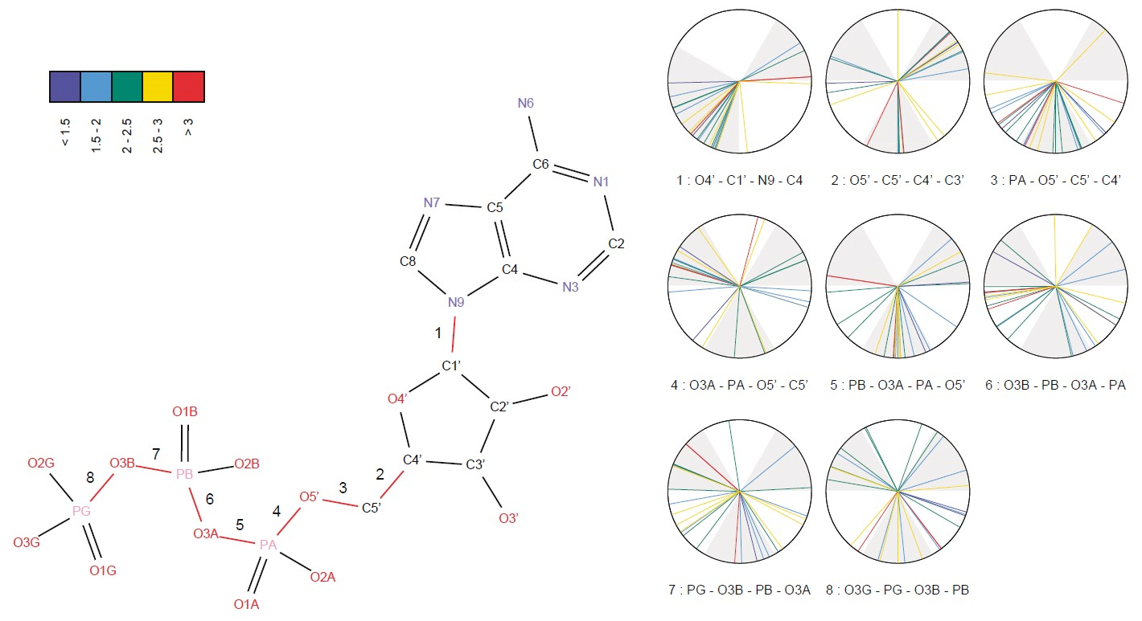
Ligand Conformational Flexibility
Torsional preferences for rotatable bonds in ATP using
27 diverse conformations based on 407 co-crystals.
[Stockwell and Thornton (2006), J. Mol. Biol. 356, 928]

Slide 8
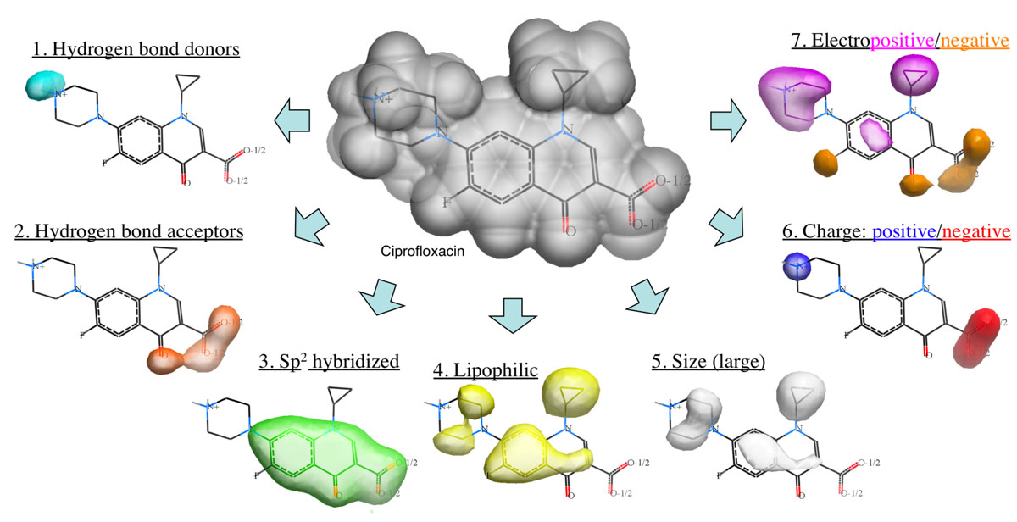
Drug Discovery: Ligand Structure Based Methods

Slide 9
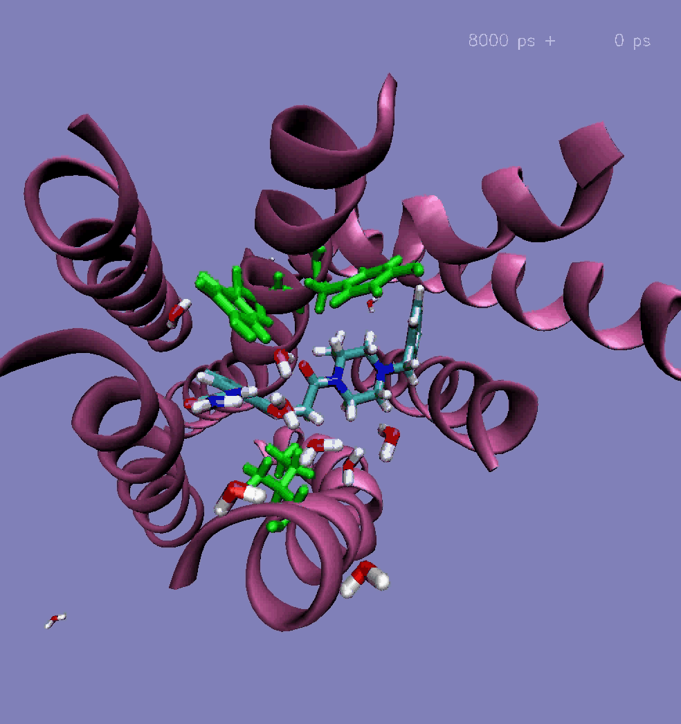
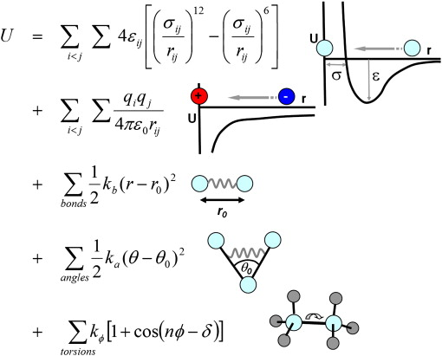
Scoring of Protein-Ligand Complexes May the Force-Field Be With You!
Source: Adv Drug Del Rev
Force Fields: Energy expressions that allow the
efficient calculation of interatomic forces. E.g.,
CHARMM, AMBER, OPLS, Dreiding, GROMOS
Vaidehi et al. (2006) J Biol Chem,281:27613.

Slide 10
Specific Aims
1. Extract PLIP Contacts for any ligand bound to a protein chain from XML to JSON
2. Differential analysis of two different ligands bound to the same binding site
3. Create an iCn3D widget for protein-ligand interactions and differential analysis
4. Assign Force-Field based energies to the individual interactions identified by PLIP.

Slide 11
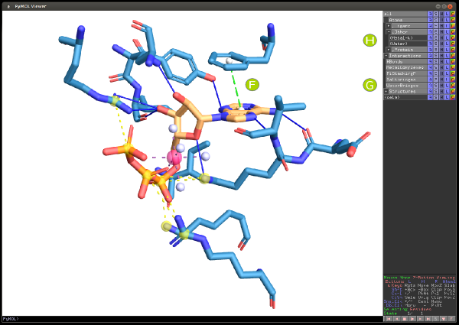
Tools/Databases Used
PLIP Server https://projects.biotec.tu-dresden.de/plip-web/plip
PDB: https://www.rcsb.org
NAMD/GROMACS:
Python scripts
….
….

Slide 12
Team 3A Tasks
1. Extract PLIP Contacts for any ligand bound to a protein chain from XML to JSON
2. Differential analysis of two different ligands bound to the same binding site
3. Create an iCn3D widget for protein-ligand interactions and differential analysis
4. Assign Force-Field based energies to the individual interactions identified by PLIP.
Team member name | Expertise | Tentative task assignment
Sreeranjini Babu | c/c++
Sridhar Malkaram | shell, python, R | 4, writer
Aaron Ayllon-Benitez | js, R, Python, C++, MySQL | 1,3
Rachita K Kumar | python, R, MySQL | 2
Sangram Keshari Sahu | shell, python, R, xml/json
Ravi Abrol | shell, python | 1,4, sys admin

Slide 13
1. Extract PLIP Contacts for any ligand bound to a protein chain from XML to JSON -Aaron
PDBID input
Protein-Ligand Interaction Profiler
XML result
Python script
JSON file
Notes:
We need a PDB id to use as input into the Protein-Ligan interaction progiler (PLIP)
Then the results is a XML
I did a python script that transform all the XML in a JSON file
Next step is to adapt this JSON into the ICn3D JSON specification

Slide 14
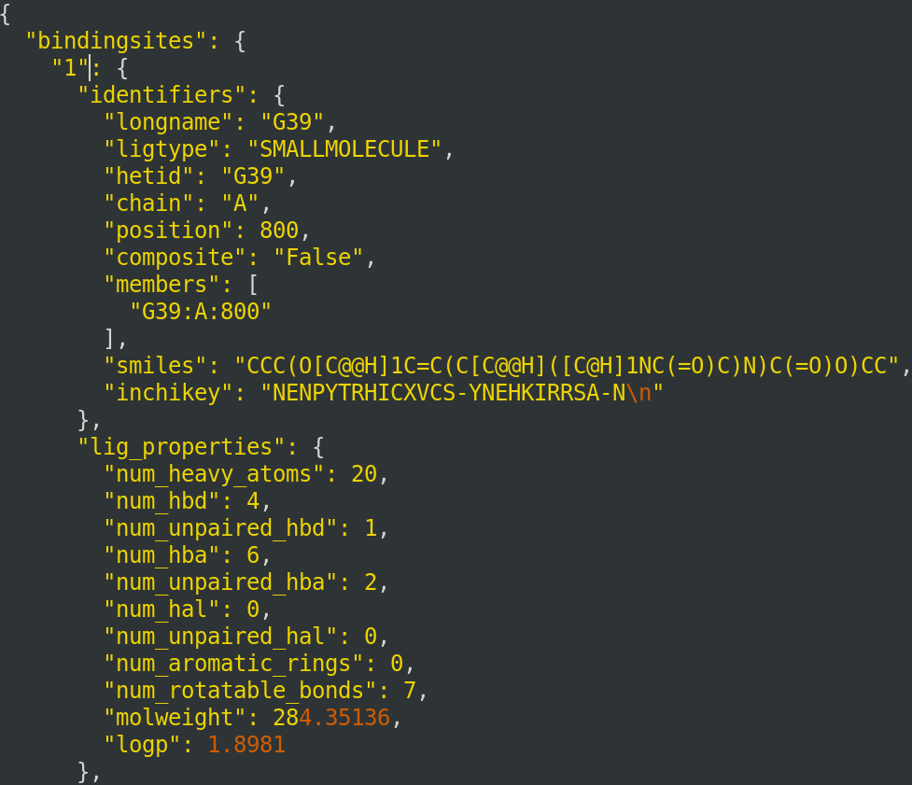
Root
bindsite 1
Identifiers
longname
ligtype hetid
chain
positions
smiles structure
...
lig_properties
bs_residues
bs_residue 1
bs_residue 2
…
interactions
hydrophobic_interactions
hydrophobic_interaction 1
INFO
…
hydrogen_bonds
hydrogen_bond 1
INFO
…
bindsite 2
...
TREE FORMAT

Slide 15
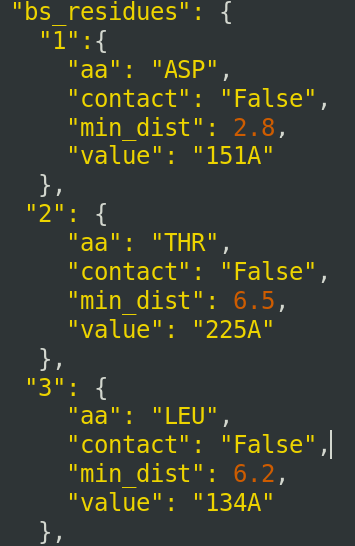
Root
bindsite 1
Identifiers
longname
ligtype hetid
chain
positions
smiles structure
lig_properties
bs_residues
bs_residue 1
bs_residue 2
…
interactions
hydrophobic_interactions
hydrophobic_interaction 1
INFO
…
hydrogen_bonds
hydrogen_bond 1
INFO
…
bindsite 2
...
TREE FORMAT

Slide 16
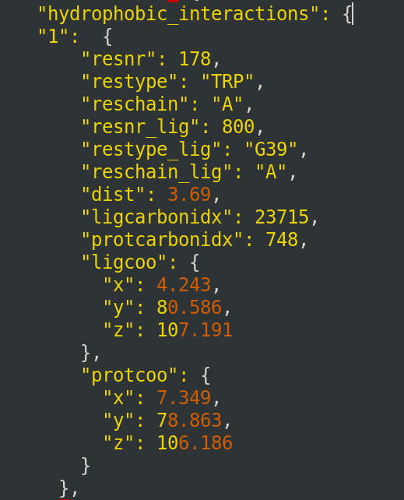
Root
bindsite 1
Identifiers
longname
ligtype hetid
chain
positions
smiles structure
lig_properties
bs_residues
bs_residue 1
bs_residue 2
…
interactions
hydrophobic_interactions
hydrophobic_interaction 1
INFO
…
hydrogen_bonds
hydrogen_bond 1
INFO
…
bindsite 2
...
TREE FORMAT

Slide 17
2. Differential analysis of two different ligands bound to the same binding site -Rachita
JSON
input
Map different types of interactions for each binding site, for Neuraminidase when in complex with Zanamvir and Oseltamivir
(Python script)
CSV
output
Example: Neuraminidase in complex with Zanamvir and Oseltamivir
Notes:
We need a PDB id to use as input into the Protein-Ligan interaction progiler (PLIP)
Then the results is a XML
I did a python script that transform all the XML in a JSON file
Next step is to adapt this JSON into the ICn3D JSON specification

Slide 18
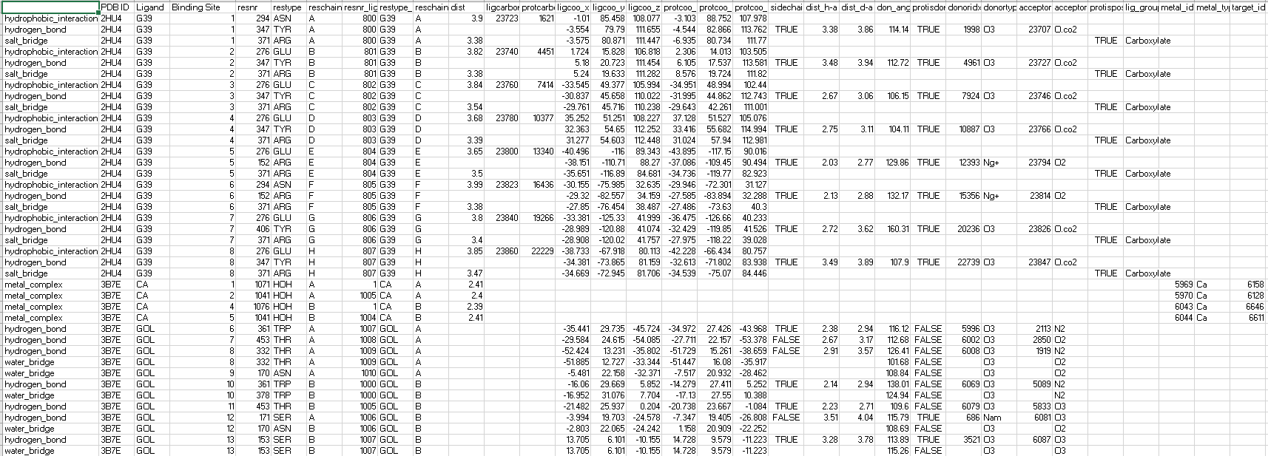
Interactions: CSV ouput

Slide 19
Team 3A: TBD
1. Extract PLIP Contacts for any ligand bound to a protein chain from XML to JSON
2. Differential analysis of two different ligands bound to the same binding site
3. Create an iCn3D widget for protein-ligand interactions and differential analysis
4. Assign Force-Field based energies to the individual interactions identified by PLIP
Team member name | Expertise | Tentative task assignment
Sreeranjini Babu | c/c++
Sridhar Malkaram | shell, python, R | 4, writer
Aaron Ayllon-Benitez | js, R, Python, C++, MySQL | 1,3
Rachita K Kumar | python, R, MySQL | 2
Sangram Keshari Sahu | shell, python, R, xml/json
Ravi Abrol | shell, python | 1,4, sys admin

Slide 20
(TBD) 3. Create an iCn3D widget for protein-ligand interactions and differential analysis
Team3A (Aaron, …)
Team 1/2/4 (Jiyao, …)

Slide 21
(TBD) 4 . Assign Force-Field based energies to the individual interactions identified by PLIP
Interaction list
CSV input
Extract interaction energies for the list
(Python script)
Create ligand topology (GROMACS/NAMD)
Run Force-field energy calculation (GROMACS/NAMD)
Interaction energies
JSON/CSV
output

Slide 22
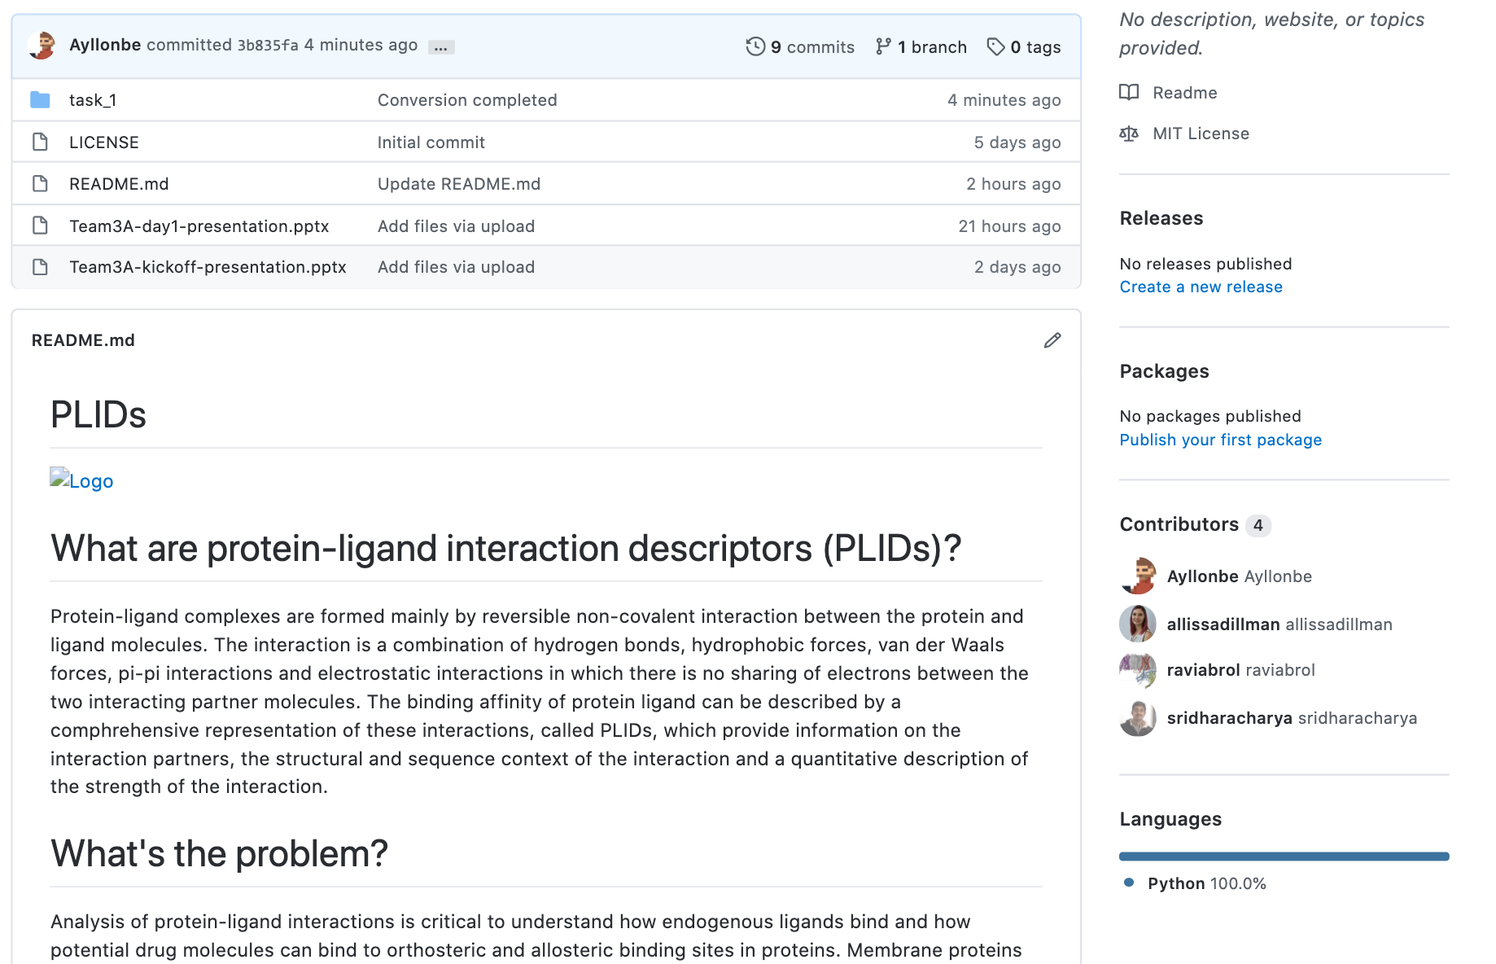
Team 3A: Github

